Slide 1
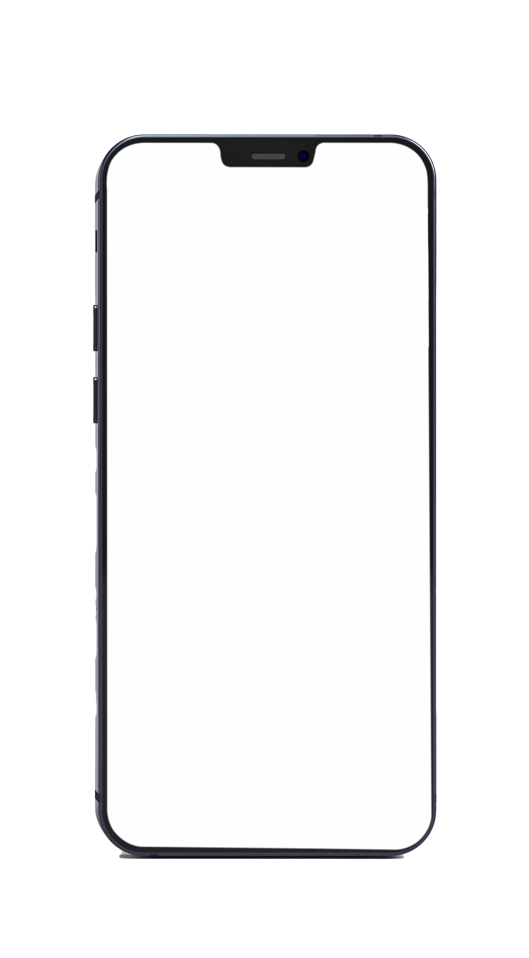

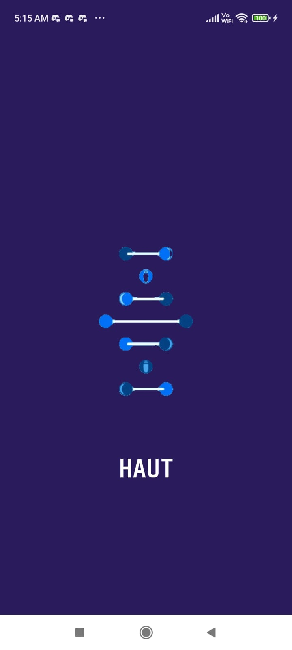
HAut - Public Health
Skin Cancer Detection App
Sigmoids
K!ode-a-thon Project Proposal

Slide 2
Table of contents
01
Problem Statement
& Solution
02
Novelty
03
04
ML Model + App
UI/UX Mockup
05
06
Demo
Developers

Slide 3
01
Problem Statement
& Soln.
Sigmoids

Slide 4
As we all know that the world is permanently moving in online mode by all possible ways and after the end of this pandemic people will prefer 'Go online' in every walk of life but this new era comes with many problems which need to be solved.
In the upcoming scenario of 'sustainable new normal', everything is about to get digitalized. We would like you to propose a solution to the medical industry for promoting touchless diagnosis.

Slide 5
For this, we planned to build an Android Application with an integrated Deep Learning Convolutional Neural Network trained on an image dataset of Skin Cancer images.
Any user having a doubt of any skin related issue do not have to directly go to Doctor in this pandemic period, instead he/she can get an idea of what the issue may be.

Slide 6
02
Novelty
Sigmoids

Slide 7
In the current era, we do have apps like Practo which recommend you doctors on the basis of symptoms you tell the app by clicking options.
But the new thing in this app is it works on the image of the skin rather than the experience by the user as the experience may be different in perspective of different beings.
So, this project uses a diversity of images, around 10000+ images to predict the disease with a good accuracy on real-world data.

Slide 8
03
ML Model + App
Sigmoids

Slide 9
Tech Stack
Python
Tensorflow
Numpy
Pandas
Matplotlib
Seaborn
Sklearn
Keras
Tensorflow Lite
Java
XML
Figma

Slide 10
ML Model (Tensorflow, Numpy, Pandas)
We chose a dataset with the following skin disease labels -
Melanocytic nevi
Melanoma
Benign keratosis-like lesions
Basal cell carcinoma
Actinic keratoses and intraepithelial carcinoma / Bowen's disease
Vascular lesions
Dermatofibroma

Slide 11
ML Model (Tensorflow, Numpy, Pandas)
We then trained the dataset with image pixels as the input features and disease labels as output over 10000+ images.
The model we are using is Convolutional Neural Network with
Input shape 28 x 28 x 3
Conv 2D layer 32, filter size 3 x 3, ReLu, padding same, followed by MaxPool layer
Conv 2D layer 64, filter size 3 x 3, ReLu, padding same, followed by MaxPool layer
Conv 2D layer 128, filter size 3 x 3, ReLu, padding same, followed by MaxPool layer
Conv 2D layer 256, filter size 3 x 3, ReLu, padding same
Flatten layer
Dense layer 128
Dense layer 64
Dense layer 32
Softmax prediction layer with 7 output nodes

Slide 12
App (Java, XML, TFLite)
We made an Android App using Android Studio (JAVA and XML).
A user friendly app which takes an image as an input and tells the user what kind of skin disease they are suffering from
App will also suggest some good doctors who can treat that specific disease.
App will use a tflite model (Tensorflow Lite model) developed by us. An image provided by the user will be analysed by tflite model to make predictions, and those predictions will be produced by tflite model in a form of float array.
This float array will be used to by the app to find the disease the user is suffering from and will suggest good doctors to the user using this data.

Slide 13
Our process
Click or Upload image on the Android App
Step 1
Step 2
Predict the Disease using tflite model in backend
Display the probability of the skin disease
Step 3
Step 4
Recommend skin specialists.

Slide 14
04
UI/UX
Mockup
Sigmoids

Slide 15
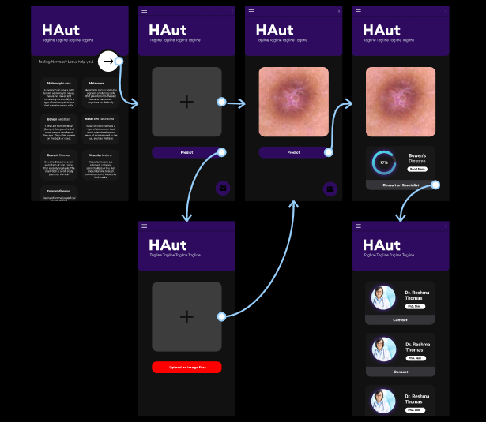
Mobile mockup (Figma)

Slide 16
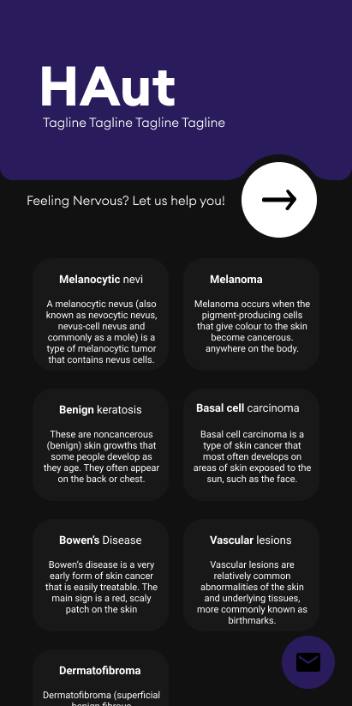
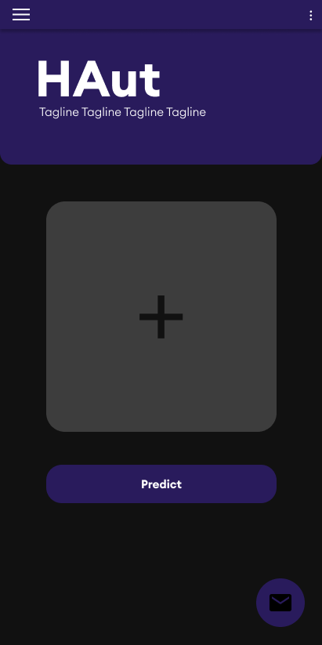
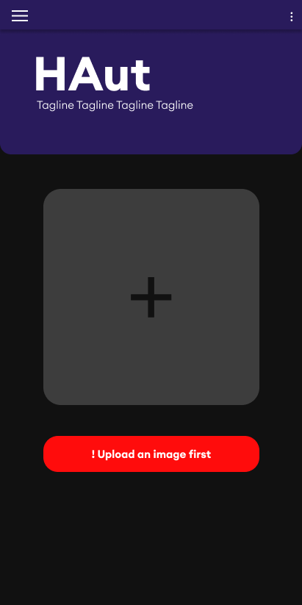
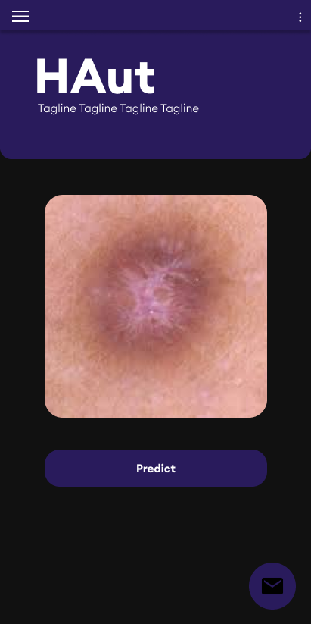
Mobile mockup (Figma)

Slide 17
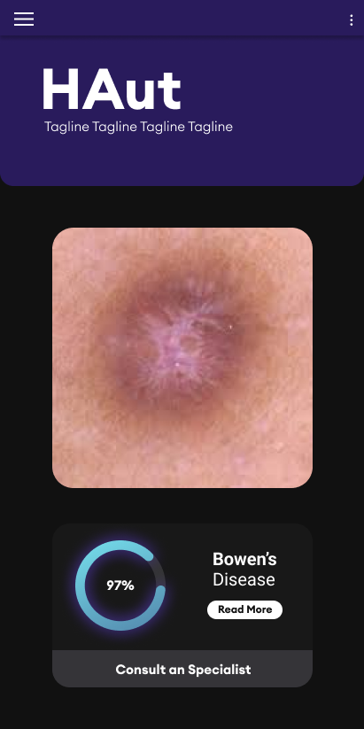
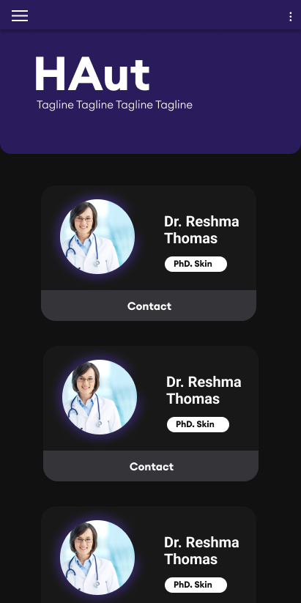
Mobile mockup (Figma)

Slide 18
05
Demo
Sigmoids

Slide 19

Mobile mockup (Figma)

Slide 20
06
Developers
Sigmoids

Slide 21

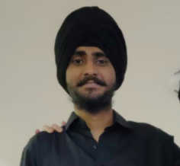
Our team
Hrithik Purwar
Raehat Singh
ML DL Enthusiast
UI/UX Developer
Android App Developer
UI/UX Developer

Slide 22
Thanks
K!ode-a-thon Project Proposal

